Slide 1
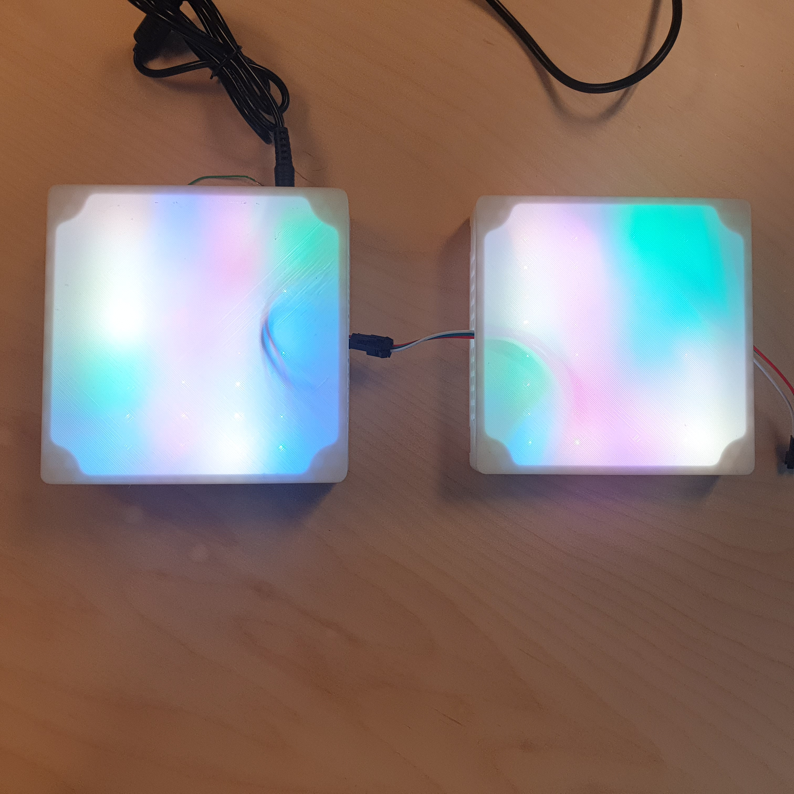
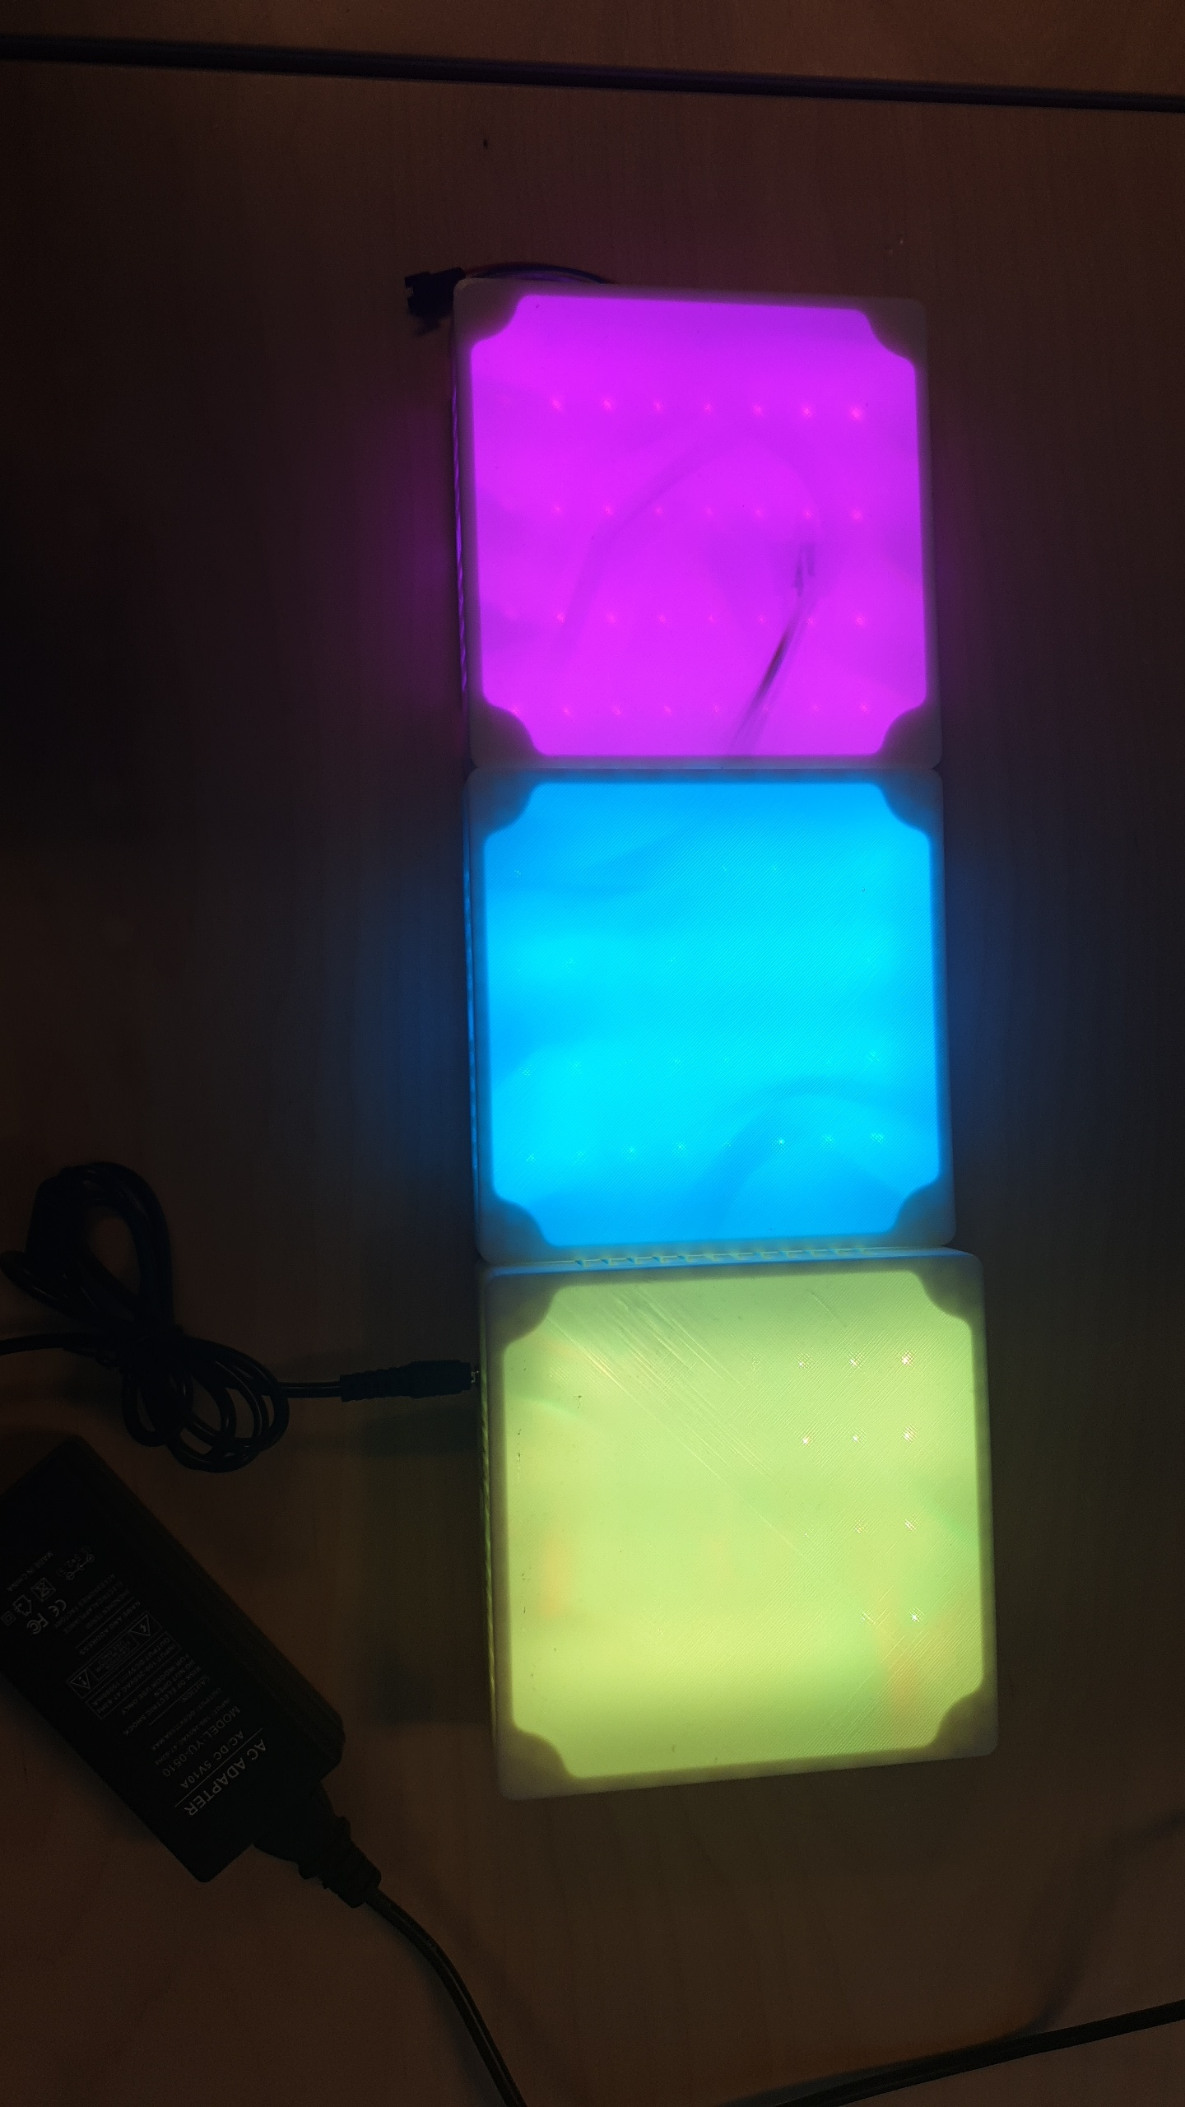
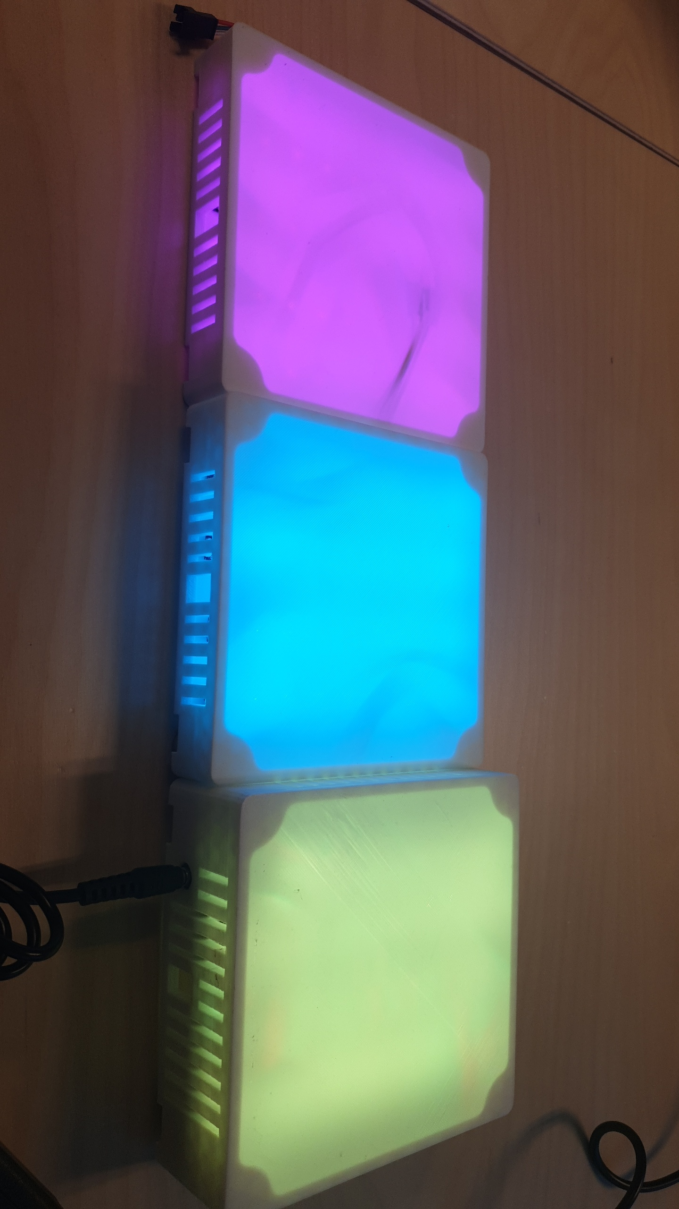


Dancing Lights
P
Instructies:
Pas de project titel aan en voeg een subtitel toe
Schrijf eronder een korte omschrijving van de probleemstelling, jullie uitwerking, de gebruikte componenten en welke leerstof jullie nodig hadden.
Vervang de 3 foto’s door mooie foto’s van jullie product/prototype.
Noteer jullie namen bij het team
Indien een leerlijn niet werd gebruikt in jullie project, vervang het vinkje dan door een leeg vierkantje.
Vervang de QR code door eentje die verwijst naar jullie GitHub repository.
The Project
We have developed a system that utilizes audio as input to generate an interactive light show as output. This system, called 'Dancing Lights,' consists of three key components:
1. LED Lighting
For our light show, we used Neon LED lighting, enriching the experience with color and interactivity.
2. Raspberry Pi
To power and operate this system, we utilized a powerful yet user-friendly Raspberry Pi. This allows us to continuously expand and customize the project, making it future-proof.
3. Sound Sensor
As audio serves as the input for our system, we integrated a sound sensor to detect sound changes rather than just frequencies.
This project was challenging as it required both hardware and software expertise. We had to delve into new subjects and techniques, and collaboration was essential in building this entirely new system. Although it was hard work, it provided highly valuable learning moments for all of us. This experience has better equipped us to confidently tackle future projects.
Professional Bachelor's Degree in Electronics-ICT
Software Engineering
Hardware Engineering
Network-&System administration
Artificial Intelligence
Personal development
Team
Mirko Sinnaeve, fase 3, Software/AI engineer
Esteban Desmedt, fase 2, Software/AI engineer
Seraphin Sampers , fase 2, Software/AI engineer
William Rogov, fase 2, Software/AI engineer
Elias Vanthorre, fase 2, Network & System Admin

